Slide 1

EDA Capstone Project
Team Members
Abhishek Kumar
Mohita Rathour
Mukesh Kumar Sablani
Sanjay Paul

Slide 2
Introduction
A few decades ago, traveling was not a part of everyday life. But today travel is an enormous budding industry of 8.8 trillion economy. This directly affects the hotel industry which is highly competitive.
We are here with a compact data to study about the hotel industry, mainly the booking. We are focussing on two types of hotels in this study. This data set contains different hotel types, countries located, guest, stays. Also the study have some factors that affect booking like wait time, lead time , months, average daily rate etc.
By the end we will conclude the study with following insights:-
Best time for booking
Optimal duration of stay
Distribution Segment and market segments to be focused to increase revenue
Factors leading to cancellation which affects the revenue.
Factors like meals, special requests etc. which might affect in the increase of ADR and revenue.

Slide 3
Workflow
Problem Statement and Collection of raw data
Data cleaning and Data Manipulation
Exploratory Data Analysis
Data visualization
Analyzing the result
Firstly identify the problem or the analysis to be done and then collect the data regarding it
Raw data will be having a lot of null values, outliers and out of format data. So it needs to be cleaned before working on it.
Using the technical skills(python) we need to code to study and extract results.
The result will then be displayed in a visualization manner as in graphs for a better understanding..
With the results from the EDA and the visualization we can conclude analysis
1
2
3
4
5
For this project we have used this workflow to analyse the hotel booking data

Slide 4
Attributes in the study
This data has 119390 rows and 32 columns. Here are the columns
Hotel
Is_cancelled
Arrival_date_year
Arrival_date_month
Arrival_date_week_number
Day_of_the_month
Stays_in_weekend_nights
Stays_in_week_nights
Adults
Children
Babies
Meals
Country
Market_segment
Distribution Channel
Is_repeated_guest
Previous_cancellations
Previous_bookings_not_canceled
Reserved_room_type
Assigned_room_type
Booking_changes
Deposit_type
Agent
Lead_time
Days_in_waiting_list
Customer_type
Adr
Required_car_parking_spaces
Booking changes
Reservation_status
reservation_status_date

Slide 5
Data Wrangling
Data Cleaning:-
Dropping Columns with Maximum Null values– agent and company
Dropping columns which had redundant values– Arrival_date_week_number
Columns with nominal null values have been manipulated by filling them with
Numerical column:- Median (Number of children)
String column:- Mode (Country)
Data Manipulation:-
Combining columns for an effective study
kids=babies+children
total_stays= Stays_in_weekend_nights+Stays_in_week_nights
Revenue=total_stays(Non_cancelled guests)*ADR

Slide 6

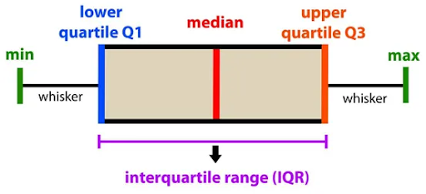
Handling Outliers
Interquartile range:-

Slide 7
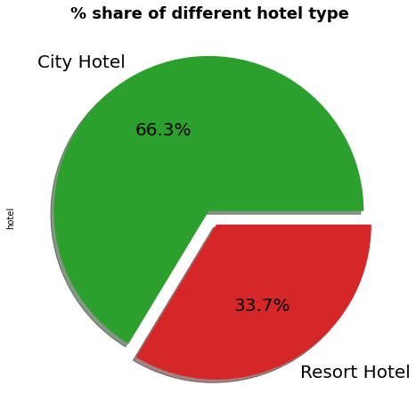
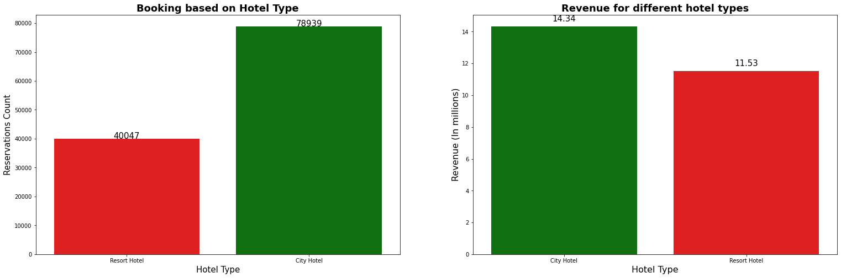
Percentage share of different hotel type and their booking and revenue for different hotel type
City Hotels are most preferred hotel by guests.
Bookings are double for City hotel but the revenue difference is not much in between them.
This shows that Resort hotels are bit expensive as compared to City hotels.

Slide 8
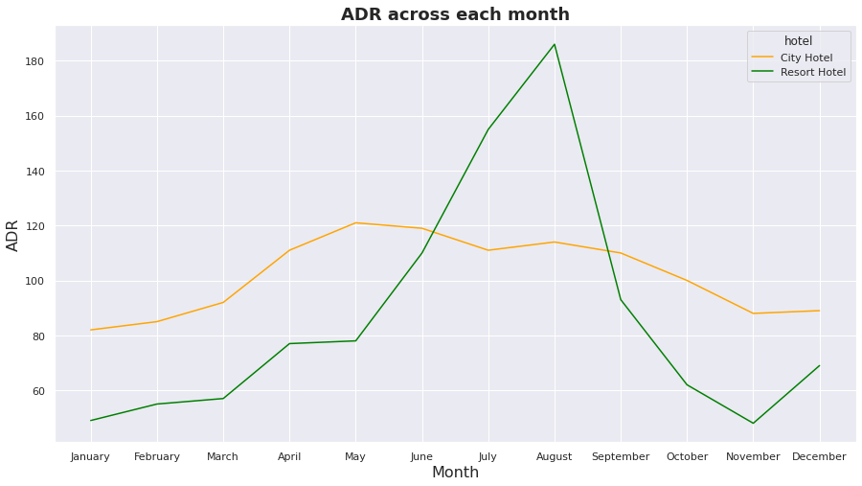
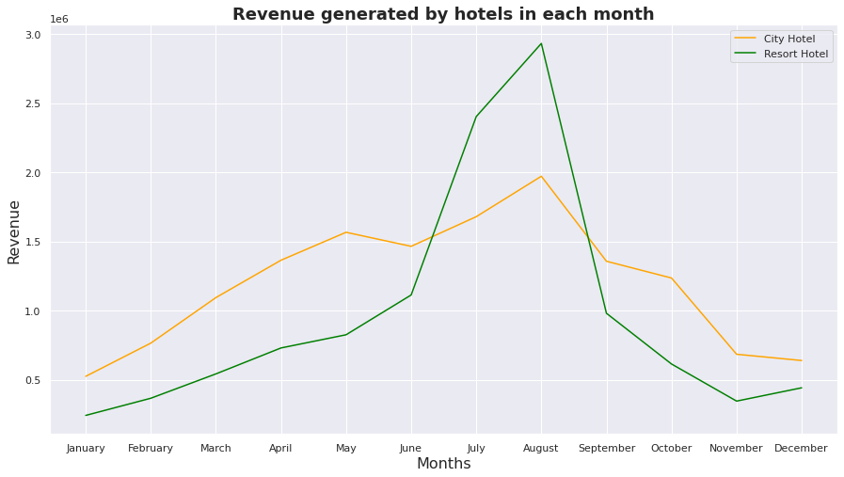
Analysis of ADR & Revenue for each month
For Resort hotel-- ADR is increasing between May to September and then started falling down, so best time to book a resort hotel is from October to April as we are getting lower ADR.
For City hotel--City hotels have nearly constant ADR from April to September and after that ADR start decreasing, so the best time to book a City hotel is from October to March.
Resort hotels and City hotels both are getting higher revenue between June to September. This is also because at same time ADR is also high for both type of hotel as shown in previous slide. Hence this period is best for hotel to generate more revenue.

Slide 9
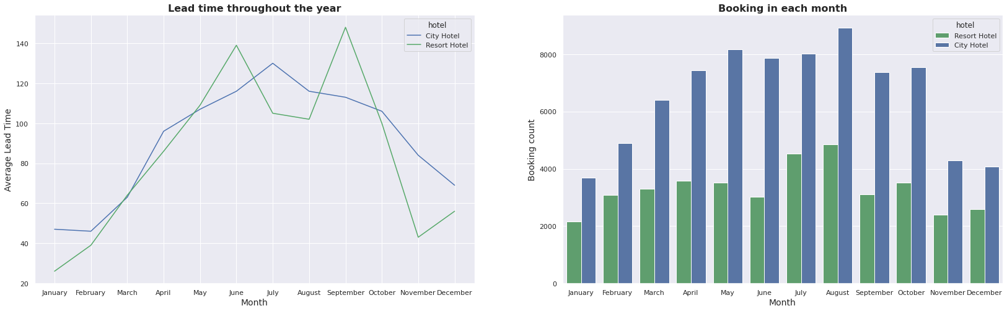
Comparative study of reservation based on lead time and booking of hotels in each month
From the above graph we can see in city hotels there is a peak from April to July and the booking is high in August. And in resort hotels we can see two peaks, first in June and second in September and booking is high in July,August and October, so people usually book hotel 30-60 days in advance.

Slide 10
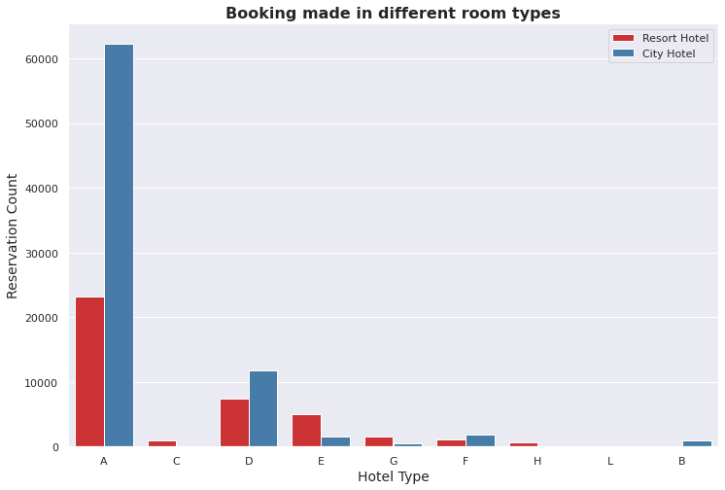
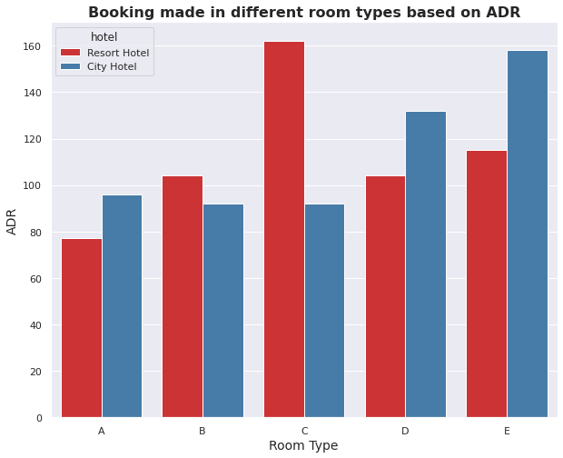
Preference of different room type
Majority of people prefers room type-A seems to be more economical for booking as it has the least ADR. And the booking for room type-C is less as the ADR is higher .

Slide 11
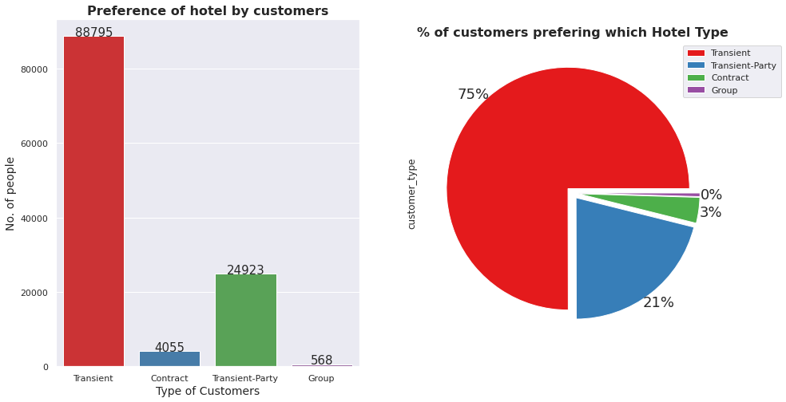
Hotel preference by different customer type
75% of bookings are done by Transient customer type.

Slide 12
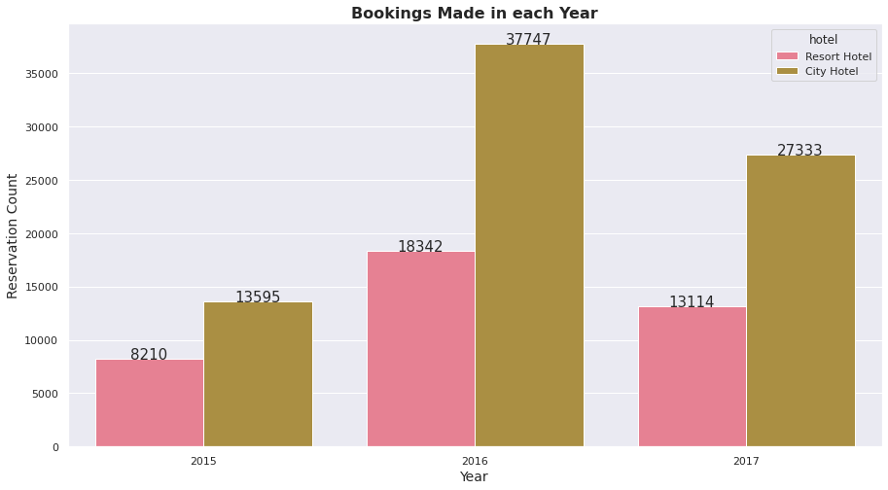
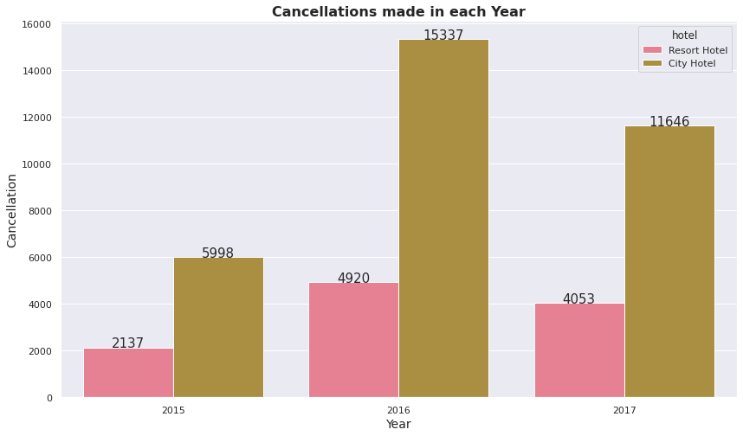
Yearly bookings & cancellations
It seems that 2016 to be the year where the hotel bookings are highest. Every year 25-30% cancellations are received for resort hotels and 40-45% cancellations are received for city hotels.

Slide 13
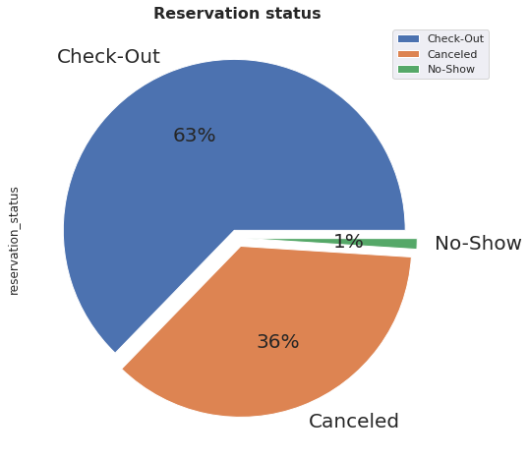
Analysis based on reservation status
Out of total no of reservations 63% actually show up, 36% got canceled, and only 1% reservation got No-show.

Slide 14
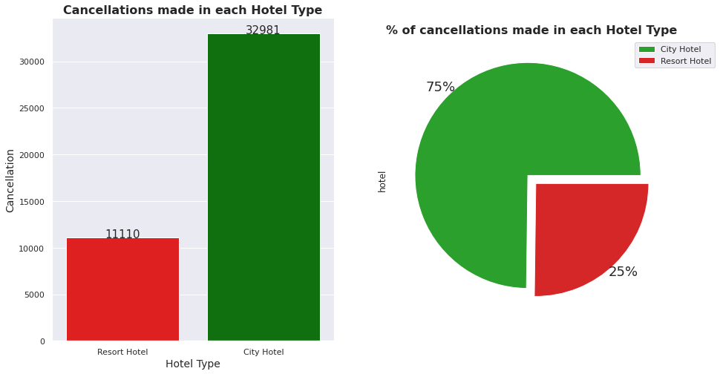
Cancellation made in each hotel type
Cancellation is less in Resort hotels as compared to City hotels.
Cancellation rate is 75% in City hotels as compared to 25% in Resort hotels.

Slide 15
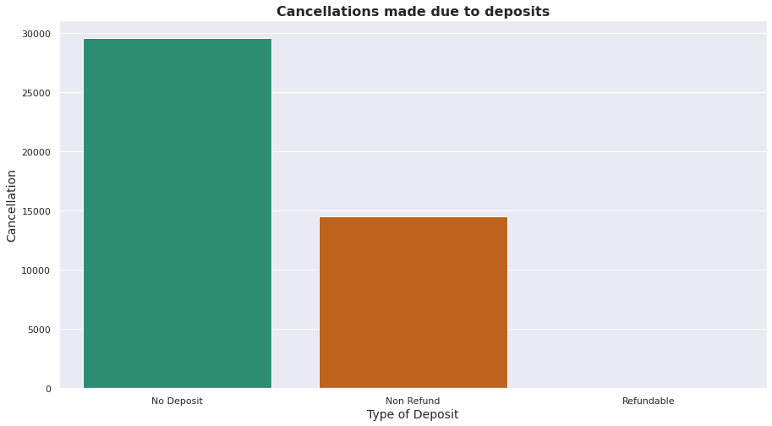
Cancellations made due to deposits.
Chances of cancellation is high when there is no deposits taken by hotels. So minimum deposits should be taken by hotels to decrease the rate of cancellation.

Slide 16
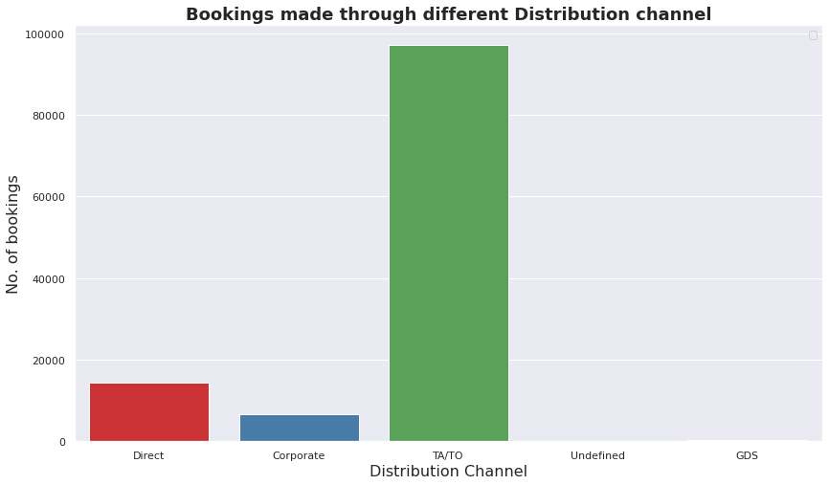
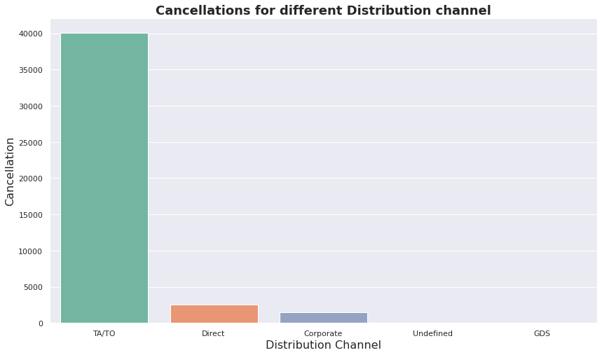
Analysis of Distribution channels
Majority of the bookings and cancellations are made through Travel agencies(Online/Offline) and Tour Operators

Slide 17
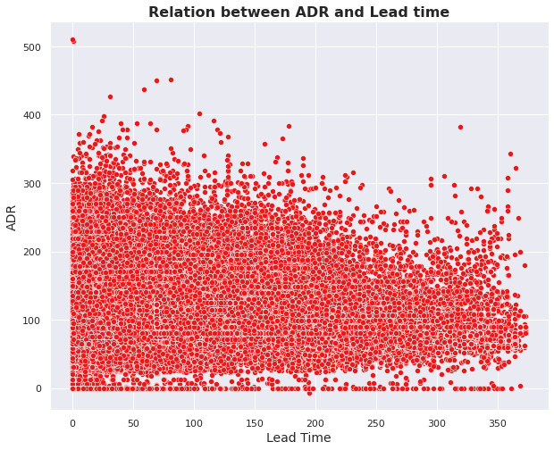
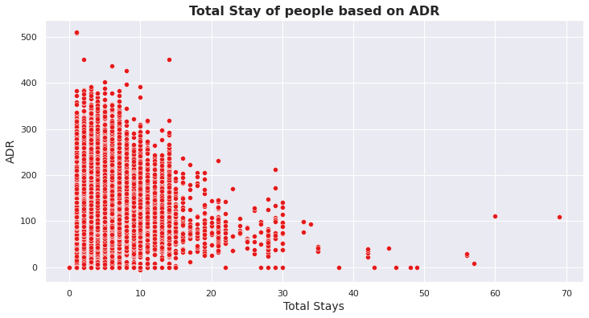
Analysis based on ADR
Here we can see that as the lead time increases ADR decreases. This means if a customer book a hotel in advance, he can get a better deal.
From the scatter plot we can see that as length of total stay increases as the adr decreases. This means for longer stay, the better deal for customer can be finalised.

Slide 18
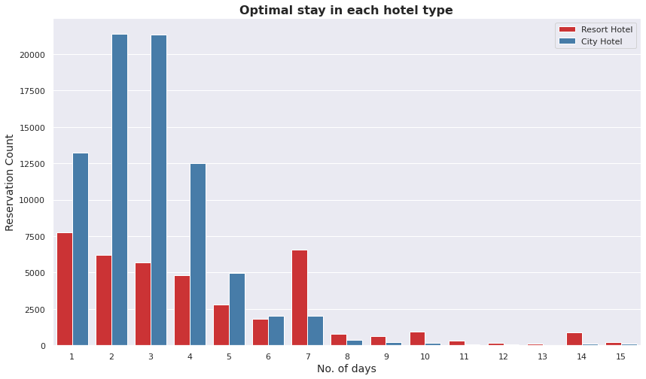
Preferred stay period
It can be stated that generally people prefer city hotels for shorter stay and resort hotels for longer stay. Prefered stay in city hotel is between 1 to 4 days and 1 to 7 days in resort hotel.

Slide 19
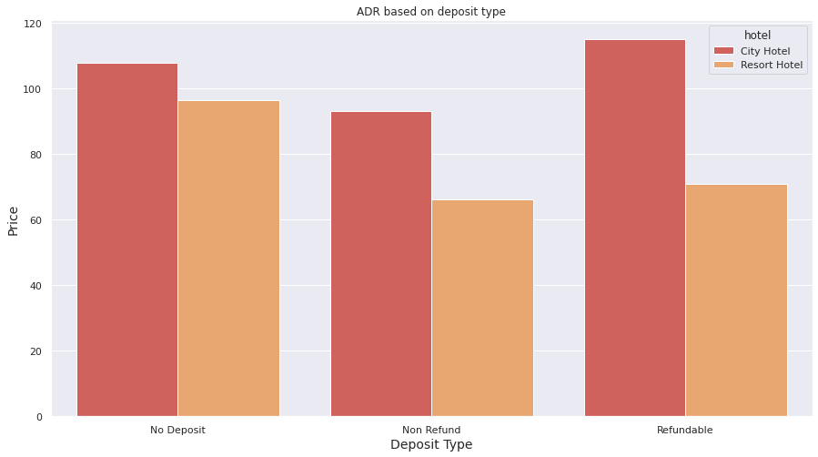
ADR based on deposit type
Hotels having refundable policy are having higher ADR where as hotel with no-refund policy are charging less.

Slide 20
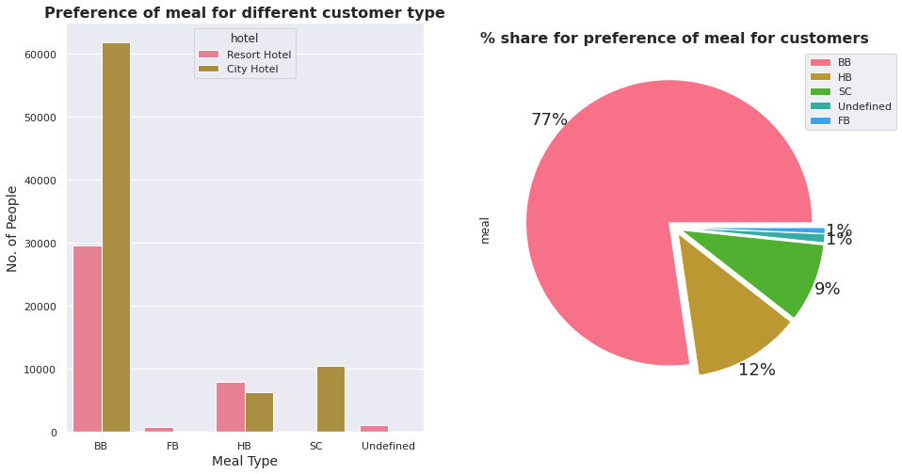
Analysis based on Meal
77% of the people prefer BB (bed & breakfast) meal type in both the hotel type.

Slide 21
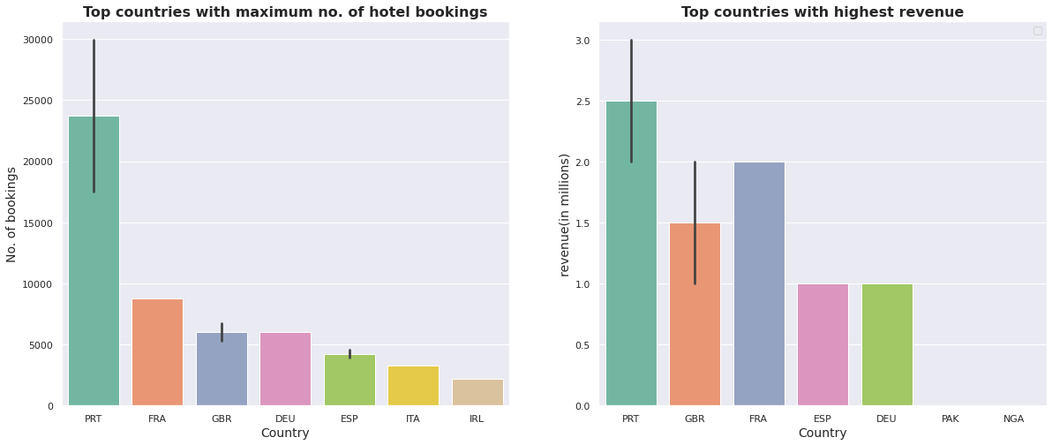
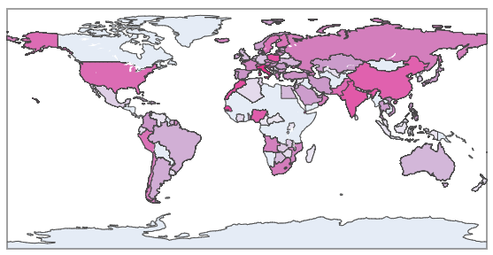

Analysis based on Country
We have a huge number of visitors from western Europe namely Portugal, France, UK and same countries generate highest revenue.
European and South-East Asian countries have the highest ADR and African countries have lowest ADR..
Notes:
?

Slide 22
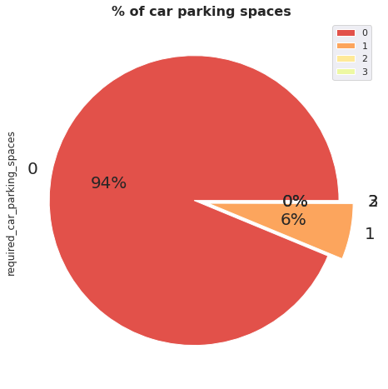
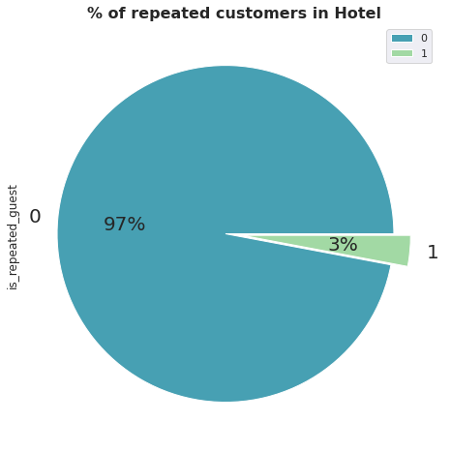
Car parking and Repeated customers insights
About 94% of people don't require the car parking spaces while booking hotel.
Major share i.e Approx 97% are new customers.

Slide 23
Conclusions
City Hotels are the most preferred hotel type generating the maximum revenue.
Resort hotels are more expensive and receive less cancellation compared to City hotels.
Out of total reservations ⅔ of people actually show up and ⅓ people cancel their booking and 1% don’t show up.
In the year 2016 the hotel bookings are highest, in which 25-30% cancellations are for Resort hotels and 40-45% cancellations are for City hotels.
As lead time increases ADR decreases, so majority of people prefer to book hotel in advance.
Best time to book a hotel is in between October to March when price of hotels is less, so hotels should provide exciting offers for customers.
Most of bookings are done by transient type of customers. So hotels should focus on attracting other customer types also to increase their revenue.
Majority of people prefers room type-A as it seems to be more economical for booking. So hotels should increase the no. of rooms in this segment.
Majority of the bookings and cancellations are made through Travel agencies and Tour Operators so hotels should work with these travel agencies to reach out to the customers for booking.

Slide 24
Conclusions
Chances of cancellation is high when there is no deposits taken by hotels. So minimum deposits should be taken by hotels to decrease the rate of cancellation.
As length of total stay increases the adr decreases. This means for longer stay, customer can get a better deal.
77% of the people prefer BB (bed & breakfast) meal type in both the hotel type.
Maximum bookings and revenues are generated from western European countries like Portugal,France, UK.so hotels should target these countries for their promotional activities.
About 94% of people don't require the car parking spaces while booking hotel.hotels should not Invest more on car parking space.
Mostly the guests are new customers and very small share for repeated customers.In order to retain the guests, hotels should take feedbacks from guests and try to improve the services to increase customer retention.

Slide 25


